Slide 1

AI Agent
Technologies
Structure
Modes
Hybrid
Cyber - Agent
Saadeddine Dakdouki 6308
-
Presented to Dr Mohamad Aoude

Slide 2





Page 01
Technologies
Structure
Modes
Hybrid
Key Technologies Used
Python 3.11
ReactJS
PostgreSQL
FastAPI
Github
Docker

Slide 3

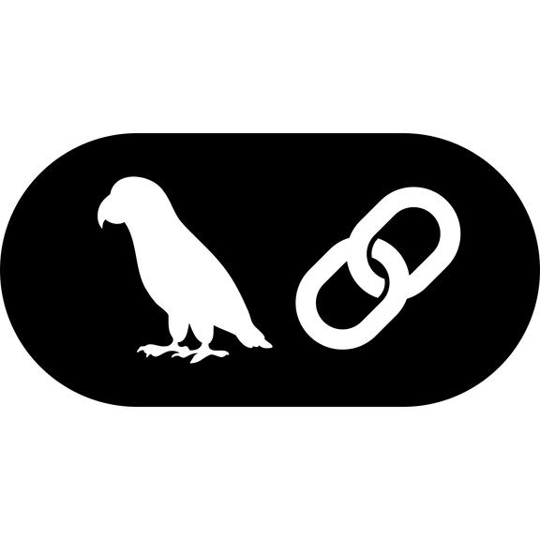


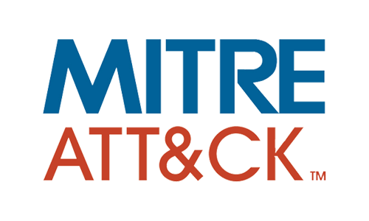

Page 02
Technologies
Structure
Modes
Hybrid
Specific Technologies
Gemini 2.0 Flash
LangChain
BurpSuite Pro
MITRE Framework
OWASP Top 10
Llama3

Slide 4
Page 03
Technologies
Structure
Modes
Hybrid
Project Structure
Main Parts
Frontend
Modern UI/UX Design
Secure Authentication Flow
Interactive Security Dashboard
Backend
RESTful API Architecture
AI Agent Framework
Asynchronous Processing
Database
Comprehensive Data Model
Security-Focused Storage
Scalable Architecture
Rule-Based Agent
MITRE ATT&CK Integration
Network Security Assessment
Risk Assessment Framework
ML Agent
Behavioral Analysis Models
Predictive Vulnerability Assessment
Adaptive Security Intelligence
Gemini AI Agent
Natural Language Security Reports
Automated Remediation Guidance
Intelligent Query Processing

Slide 5
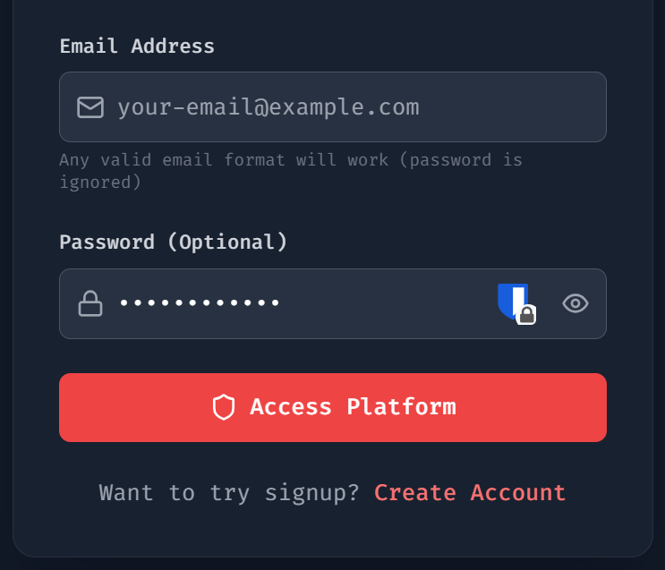
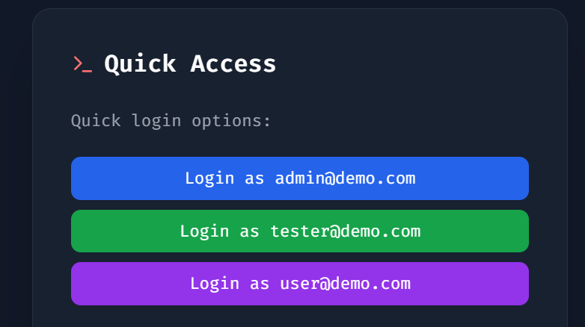
Page 04
Technologies
Structure
Modes
Hybrid
Authentication System
Login

Slide 6
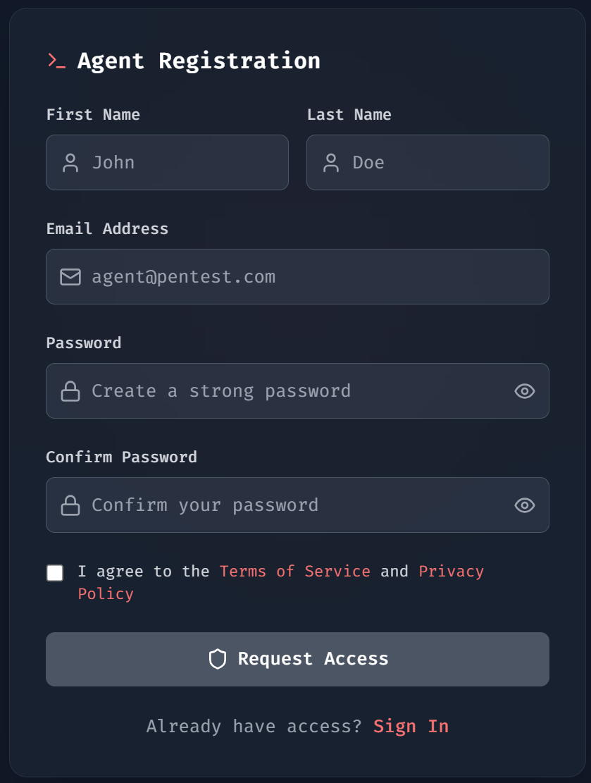
Page 05
Technologies
Structure
Modes
Hybrid
Authentication System
Register

Slide 7
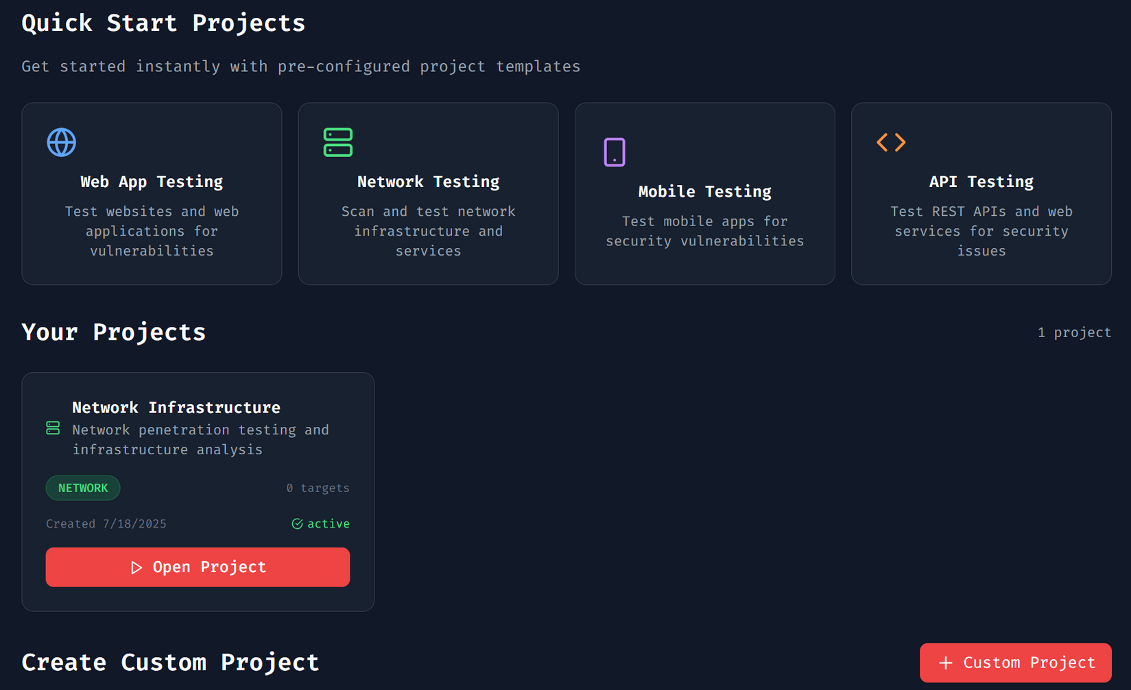
Page 06
Technologies
Structure
Sequential
Solutions
Project Selection

Slide 8
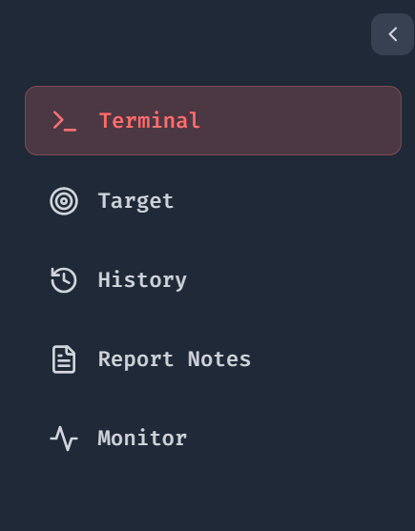
Page 06
Technologies
Structure
Modes
Hybrid
Main Page
Header + Sidebar

Slide 9
Page 07
Technologies
Structure
Modes
Hybrid
What is Network Pentesting?
Computer Network
Network Penetration Testing -> simulated cyberattack to identify and exploit vulnerabilities.
How it Works:
Scanning for open ports and services
Identifying misconfigurations and weak credentials
Attempting to exploit weaknesses
Reporting findings and recommendations
Why It’s Important:
Protects against real cyber threats
Helps organizations comply with security standards (e.g., ISO, PCI DSS)
Reduces risk of breaches and downtime

Slide 10

Page 08
Technologies
Structure
Modes
Hybrid
How the Rule-Based Engine Works
Steps performed:
Scan target IP for open ports (1–1000).
Check vulnerabilities for each service using MITRE-based rules.
Detect Operating System via TTL analysis.
Assess severity of each vulnerability (Low, Medium, High).
Generate overall Risk Score (0–100) based on:
Open ports and risky services
MITRE ATT&CK mapping
Number and severity of findings.
Outputs a comprehensive security report with prioritized risks.

Slide 11
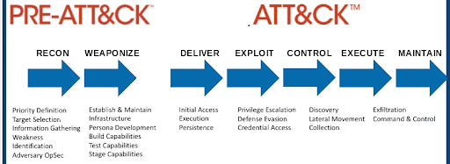
Page 09
Technologies
Structure
Modes
Hybrid
Why Use MITRE ATT&CK for Pentesting?
MITRE ATT&CK is a global knowledge base of real-world attacker tactics and techniques.
Enables consistent risk scoring and actionable defenses (firewalls, IDS, segmentation, MFA, etc.).
Ensures results are aligned with industry standards for threat modeling.
Helps map vulnerabilities to known attack behaviors:
Network discovery (T1046, T1018)
Exploiting public-facing apps (T1190)
Lateral movement via RDP/SSH (T1021.*)

Slide 12

Page 10
Technologies
Structure
Modes
Hybrid
What is Web Classification?
WORLD WIDE WEB
Web Classification is the process of analyzing and categorizing websites to determine if they are malicious (phishing) or legitimate.
How it Works:
Analyzes the URL structure (suspicious domains, typosquatting, random strings).
Checks for red flags: no SSL, suspicious redirects, or fake login pages.
Uses rule-based or machine learning detection to flag phishing behavior.
Categorizes sites as Phishing, Suspicious, or Safe.

Slide 13
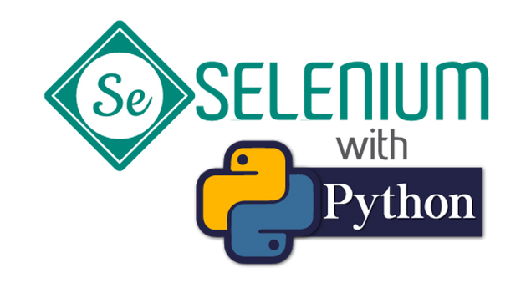

Page 11
Technologies
Structure
Modes
Hybrid
Automating Web Testing with Selenium & Browser Use
Selenium:
Automates browser actions like navigating pages, clicking buttons, and filling forms.
Used for simulating real user behavior during security testing.
Supports headless mode for silent execution or visible browsers for monitoring.
Browser Use Tool:
Extends Selenium by orchestrating full browser workflows for testing and monitoring.
Captures page content, screenshots, and behavior logs for analysis.
Integrates with other tools (e.g., BurpSuite) for traffic inspection and vulnerability testing.

Slide 14
Page 12
Technologies
Structure
Modes
Hybrid
3 STEP AI Agent
Step 1 – Website Navigation
Agent automatically navigates to the website.
Locates login or input forms (registration, contact, or credential fields).
Step 2 – Data Generation
Creates random test data for each form field.
Uses specific patterns (markers) so the inputs can be easily detected in BurpSuite logs for security testing.
Step 3 – Automated Form Filling
Agent submits the forms automatically.
Collects responses and server behavior for analysis (detecting security flaws or vulnerabilities).

Slide 15
Page 13
Technologies
Structure
Modes
Hybrid
AI-Driven Log Processing for Login Security
Step 1 – Log Capture & Filtering
BurpSuite Pro captures all HTTP traffic.
Filters are applied to extract only login-related requests and responses (e.g., form submissions, authentication endpoints).
Reduces noise and focuses analysis on critical login interactions.
Step 2 – Machine Learning Classification
A trained ML model analyzes filtered logs.
Model is trained on historical data (safe vs. malicious login patterns).
Automatically classifies activity as:
Safe (normal user behavior)
Suspicious (potential probing)
Malicious (credential stuffing, brute-force, phishing redirections)

Slide 16

Page 14
Technologies
Structure
Modes
Hybrid
2 More Steps Before Verdict
Behavioral Analysis (ML Model):
Compares a website’s behavior (redirects, hidden scripts, login prompts, domain reputation)
Matches against patterns from known malicious sites.
Flags as Safe, Suspicious, or Malicious.
Visual Brand Comparison (Rule-Based):
Analyzes the site’s logos, color schemes, layout, and text.
Compares with official brand designs to detect visual impersonation.
Flags phishing sites mimicking trusted brands.

Slide 17
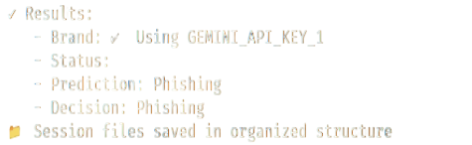
Page 15
Technologies
Structure
Modes
Hybrid
Output

Slide 18
Thank You
Saadeddine Dakdouki 6308
-
Presented to Dr Mohamad Aoude

